Slide 1
PHP | Decision Making
PHP allows us to perform actions based on some type of conditions that may be logical or comparative. Based on the result of these conditions either TRUE or FALSE, an action would be performed as asked by the user. If you want something then go this way or else turn that way
Decision making or flow control is the process of determining the order in which statements execute in a program
The special types of PHP statements used for making decisions are called decision-making statements or decision-making structures

Slide 2
Basic Decision Making
Decision making involves evaluating Boolean expressions (true / false)
If($x) “TRUE” and “FALSE” are reserved words
Initialize as $valid = false;
Compare with ==
AND and OR for combinations

Slide 3
if Statement
It is Used to execute specific programming code if the evaluation of a conditional expression returns a value of TRUE
The syntax for a simple if statement is: if (conditional expression) statement;
Contains three parts:
the keyword if
a conditional expression enclosed within parentheses
the executable statements

Slide 4
PHP CONDITIONS
PHP provides us with four conditional statements:
if statement
if…else statement
if…elseif…else statement
switch statement

Slide 5
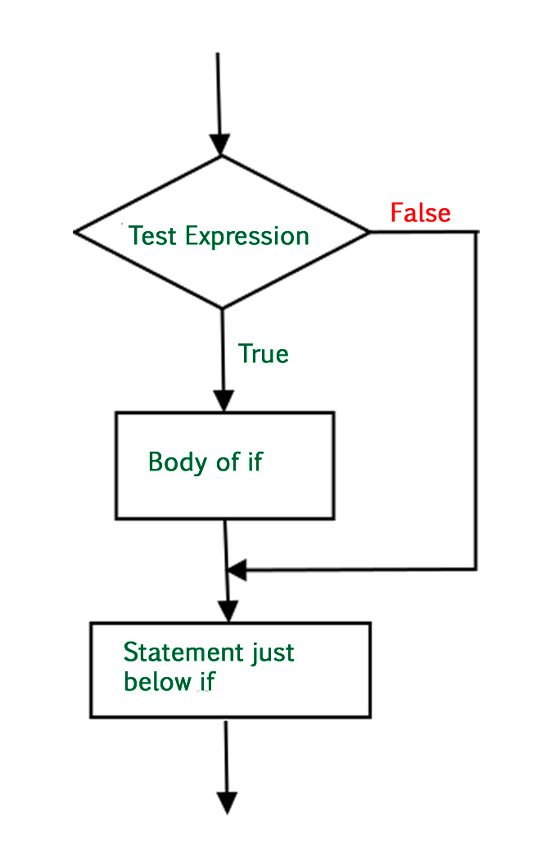
IF CONDITION
if Statement: This statement allows us to set a condition. On being TRUE, the following block of code enclosed within the if clause will be executed.
Syntax :
if (condition)
{execute this code }

Slide 6
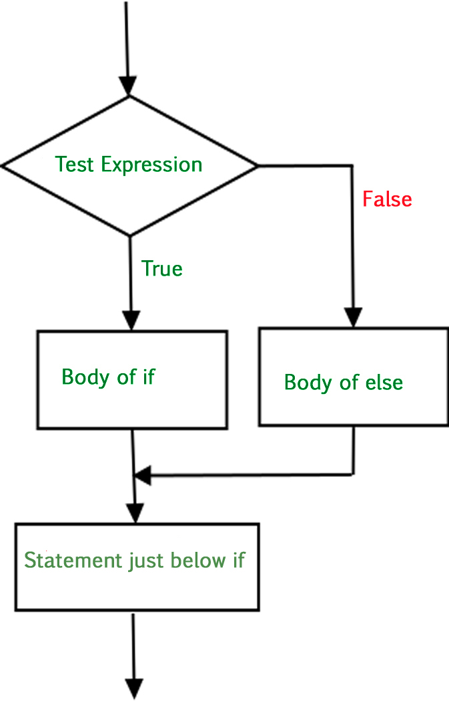
IF ELSE CONDITION
if…else Statement: We understood that if a condition will hold TRUE, then the block of code within if will be executed. But what if the condition is not TRUE and we want to perform an action then This is where else comes into play.

Slide 7
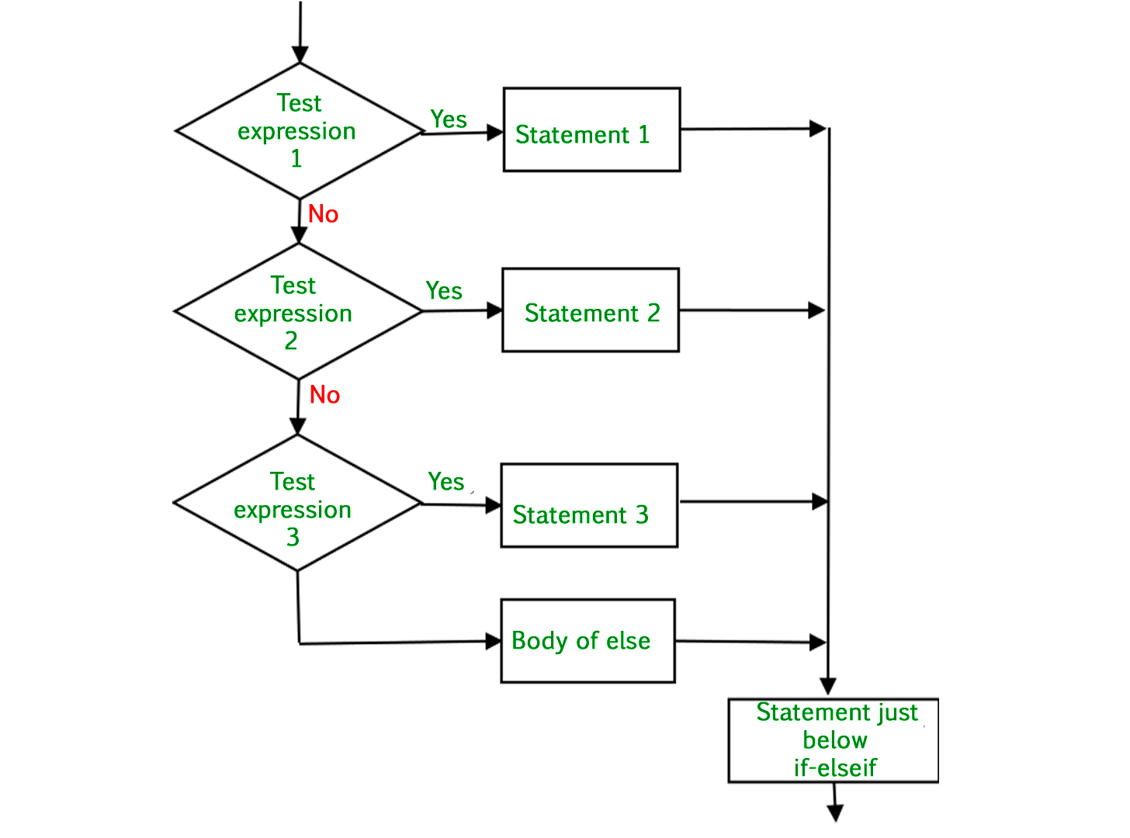
if…elseif…else Statement
This allows us to use multiple if…else statements. We use this when there are multiple conditions of TRUE cases.

Slide 8
switch Statement
Its Control program flow by executing a specific set of statements depending on the value of an expression
It Compares the value of an expression to a value contained within a special statement called a case label
A case label is a specific value that contains one or more statements that execute if the value of the case label matches the value of the switch statement’s expression

Slide 9
switch Statement
Consist of the following components :
The switch keyword
An expression
An opening brace
One or more case labels
The executable statements
The break keyword
A default label
A closing brace

Slide 10
Switch Statement
The syntax for the switch statement is :
switch (expression) {
case label:
statement(s);
break;
case label:
statement(s);
break;
...
default:
statement(s);
break;
}

Slide 11
switch Statement
A case label consists of:
The keyword case
A literal value or variable name
A colon (:)
A case label can be followed by a single statement or multiple statements
Multiple statements for a case label do not need to be enclosed within a command block

Slide 12
switch Statement
The default label contains statements that execute when the value returned by the switch statement expression does not match a case label
A default label consists of the keyword default followed by a colon (:)

